Slide 1
Endocrine System
Chemical Control

Slide 2
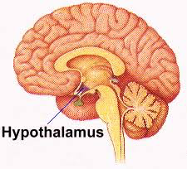
Hypothalamus
Notes:
In control of the pituitary gland maintain temp and water balance, and heart rate

Slide 3
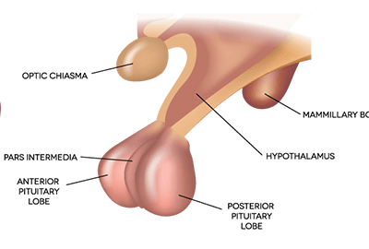
Role of the Hypothalamus
In control of the pituitary gland.
Monitors temperature and water balance.

Slide 4
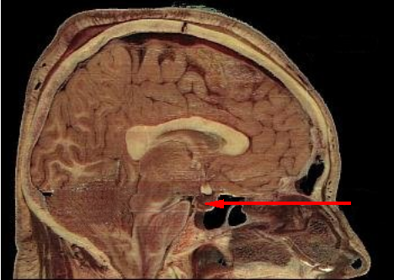
Pituitary Gland
Notes:
Influences many glands and releases several hormones

Slide 5
Role of the Pituitary
The “master gland”
Signals other glands to produce hormones
It has an anterior lobe and posterior lobe.
Anterior = creates its own hormones
Notes:
Blank last two dot points. Students take notes.

Slide 6
Role of the Pituitary
Posterior = doesn’t “create” any hormones. Hypothalamus creates hormones and they are stored in here.
Notes:
.

Slide 7
Pituitary Hormones
Gland | Principle hormones | Action
Anterior pituitary | Thyroid stimulating hormone (TSH) | Regulates thyroid gland
 | Adrenocorticotropic hormone (ACTH) | Regulates adrenal cortex
 | Growth hormone (GH) | Regulates growth in children
If done early; study labelling sheet. Test yourself silently.

Slide 8
Pituitary Hormones
Anterior Pituitary - TAG
If done early; study labelling sheet. Test yourself silently.

Slide 9
Pituitary Hormones
Gland | Principle hormones | Action
Posterior pituitary gland | Antidiuretic hormone (ADH) | Regulates water reabsorption from kidneys
Remember: made in hypothalamus. stored in posterior lobe

Slide 10
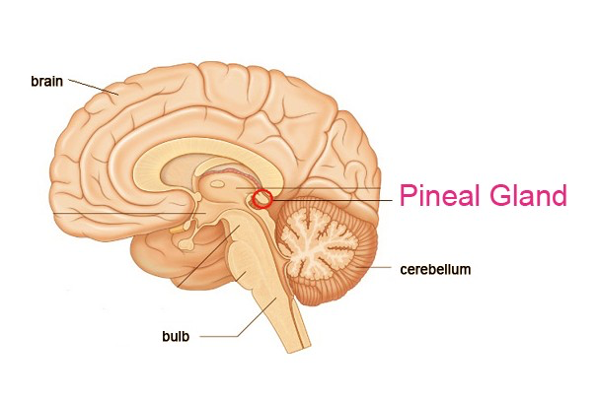
Pineal Gland

Slide 11
Role of the Pineal Gland
Gland | Principle hormones | Action
Pineal gland | melatonin | Regulates the sleep-wake cycle
Notes:
Blank last two dot points. Students take notes.

Slide 12
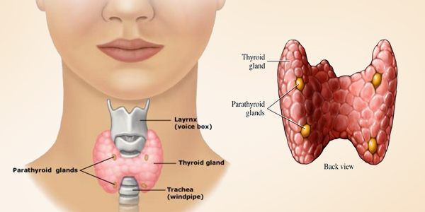
Thyroid Gland

Slide 13
Role of the Thyroid Gland
Gland | Principle hormones | Action
Thyroid gland | Thyroxine | Stimulates glucose metabolism
 | Calcitonin | Lowers blood calcium
Parathyroid gland | Parathyroid hormone | Raises calcium levels

Slide 14
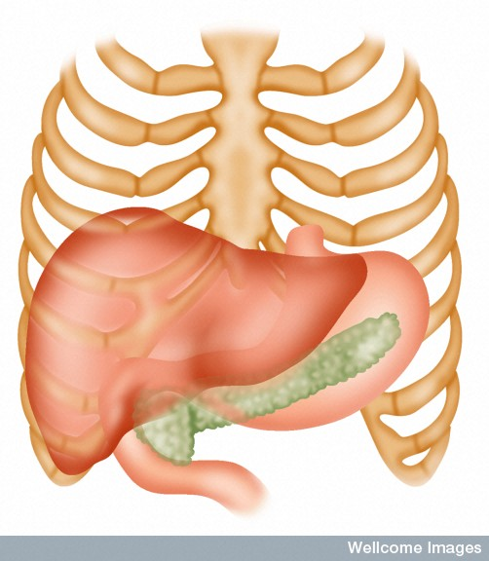
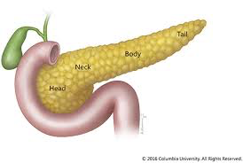
Pancreas

Slide 15
Role of the Pancreas
Gland | Principle hormones | Action
Pancreas Beta-cells | Insulin | Lowers blood glucose levels
Pancreas Alpha-cells | Glucagon | Raises blood glucose levels

Slide 16
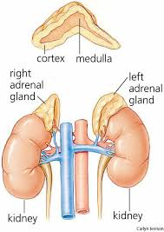
Adrenal Glands (Cortex and Medulla)
Cortex – C for Covering
Medulla – M for Middle

Slide 17
Role of the Adrenal Glands
Gland | Principle hormones | Action
Adrenal cortex (covering) | Aldosterone | Sodium metabolism
 | Cortisol | Stress response/glucose metabolism
Adrenal medulla (middle) | Adrenaline (epinephrine) | Fight or flight response
 | Noradrenaline (norepinephrine)
If done early; study labelling sheet. Test yourself silently.
Notes:
Blank last two dot points. Students take notes.

Slide 18
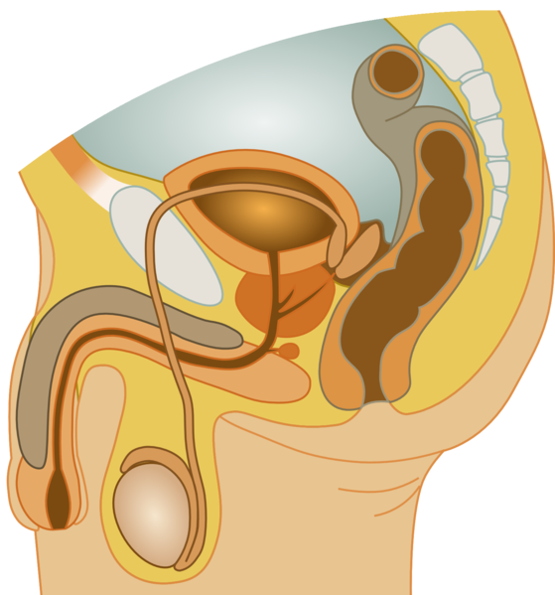
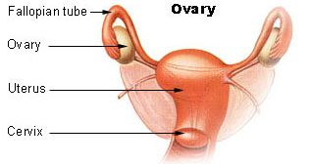
Gonads (Ovaries and Testes)

Slide 19
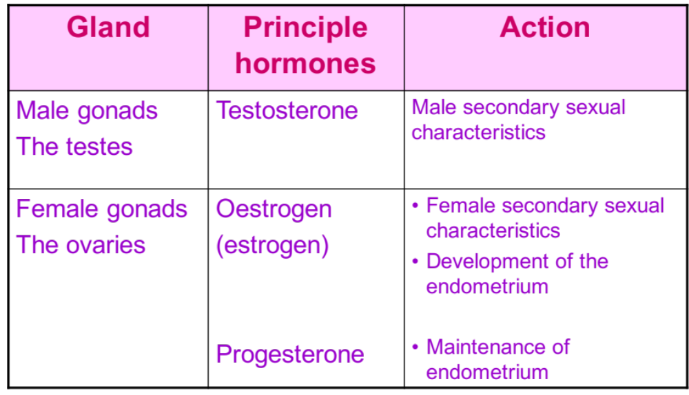
Gonads (Ovaries and Testes)

Slide 20
Placenta
Notes:
.

Slide 21
Placenta
Gland | Principle hormones | Action
Placenta | Oestrogen | Prepare mammary glands for lactation
 | Progesterone | Maintain endometrium
If done early; study labelling sheet. Test yourself silently.
Notes:
.

Slide 22

Review

Slide 23
Pituitary Gland
Notes:
Influences many glands and releases several hormones

Slide 24
Pineal Gland

Slide 25
Thyroid Gland

Slide 26
Pancreas

Slide 27
Adrenal Glands (Cortex and Medulla)
Cortex – C for Covering
Medulla – M for Middle

Slide 28
Gonads (Ovaries and Testes)

Slide 29
Placenta
Notes:
.

